Slide 1

KIDSTON SOLAR FARM PHASE 1 (KS1)
Nick Duplex (22967258)
Ken Ji (21671765)
Ninu Latheesh (23804552)
Mick Luu (22970102)
Tatenda Makova (23072009)
Pritam Suwal Shrestha (23771397)
Rachel Tausem (23071639)
GROUP 4 : TUESDAY 3pm PRAC CLASS
Video Link:
https://echo360.net.au/media/1bd05e00-5426-4310-b983-98982f137878/public

Slide 2
Coversheet checklist for group video presentation assignment
Group name | Group 4
Student group members (listed in the order in which they speak)]] | Ninu Latheesh (23804552) Nick Duplex (22967258) Mick Luu (22970102) Ken Ji (21671765) Pritam Suwal Shrestha (23771397) Tatenda Makova (23072009) Rachel Tausem (23071639)
Facilitator’s name & practical class time | Facilitator: Kelly Boden-Hawes Practical Class: Tuesday 3pm Prac Class
Name of student delegated to host Zoom meeting (for recording presentation) | Nick Duplex (22967258)
Name of student delegated to upload the group video on LMS via the Echo/lecture capture system and create a public link. | Pritam Suwal Shrestha (23771397)
Please include the video file name and time/date it was uploaded | File Name: KS1 GROUP 4 PRESENTATION.mp4 Upload Date: Friday, April 19, 2024, 9:37 AM

Slide 3





Introduction
Ninu Latheesh (23804552)
Capacity and Impact:
Generates 50 MW, powering approximately 26,500 homes annually
Contributes to sustainable development and reduces greenhouse gas emissions
Project Managed by: Genex Power
Location: Kidston, Queensland, Australia
Reduces CO2 emissions by 100,000 tonnes each year
Innovative Technology:
Utilizes cutting-edge solar photovoltaic panels with tracking systems to maximize energy capture
Essential electrical infrastructure includes inverters, transformers, and substations
Strategic Significance:
Aligns with national renewable energy goals, supported by the government and ARENA
Utilizes a former mining site, reducing environmental footprint and leveraging existing infrastructure
Community and Environmental Benefits:
Provides local jobs and economic boost during construction

Slide 4
Scope Management
Ninu Latheesh (23804552)
Reduces greenhouse gas emissions by around 100,000 tonnes of CO2 each year.
Scope
50MW annual electricity generation.
Powers approximately 26,500 homes.
Commissioning: Testing and validation of all components for safety and standard compliance.
Key Project Work Areas
Design & Engineering: Development of detailed plans for optimal performance.
Procurement: Acquisition of equipment and components for all project phases.
Construction: On-site preparation, solar panel installation, and infrastructure setup.

Slide 5
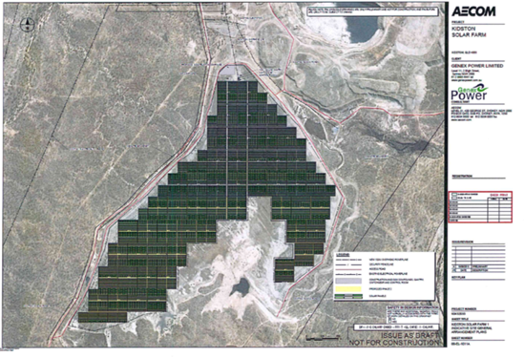
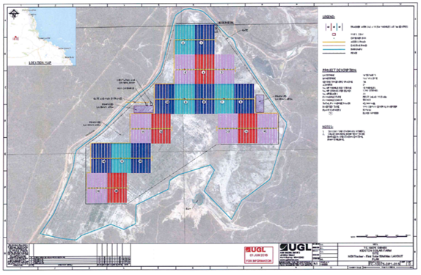
Scope Management
Ninu Latheesh (23804552)
Scope Control: No scope creep in deliverables, only in timeline and cost.
Conceptualization Stage
Objective Establishment: Clear timeline and deliverables set, targeting 50MW capacity by Q4 2017.
Project Boundaries: Defined with preliminary conceptual drawings.
Scope Management Training: Equip the team with best practices to manage and negotiate scope changes.
Recommendations for Effective Scope Management
Stakeholder Engagement: Foster continuous communication for expectation management.
Scope Baseline Adjustments: Implement review and adjustment processes at set project stages.
Scope Change Control: Establish a board for change assessment and approval.

Slide 6

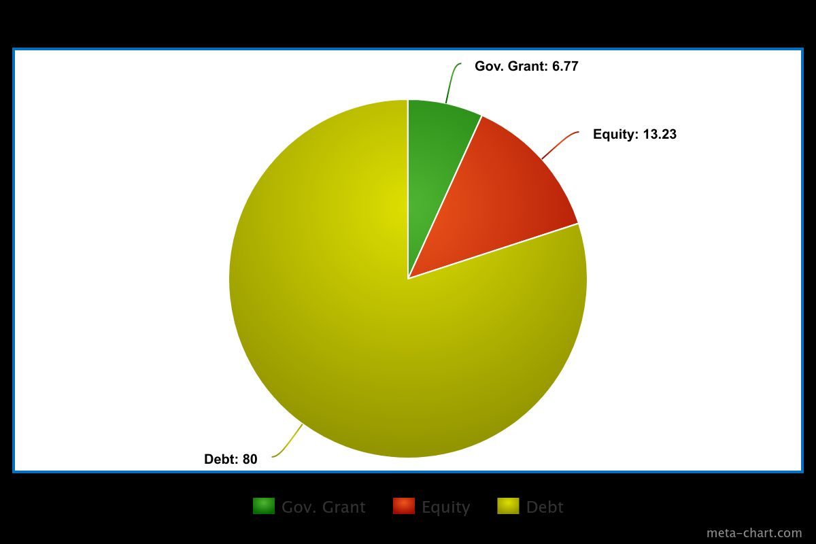
Nick Duplex (22967258)
COST MANAGEMENT: Early Estimate
The establishment of a cost management plan also remains a crucial aspect in providing a clear framework regarding all “cost estimation, budgeting and cost-controlling processes” that are necessary for the stakeholder's expectations to align (Hartley 2018, p. 208).
SOURCES OF FINANCE (%)
The project cost totalled $130.65 million AUS by finalisation in 2017 (ARENA, 2024).
80% of the budget was max percentage these banks would offer
Required the company to have some ‘skin in the game’ in terms of equity from its investors (Genex/ARENA, 2017).

Slide 7
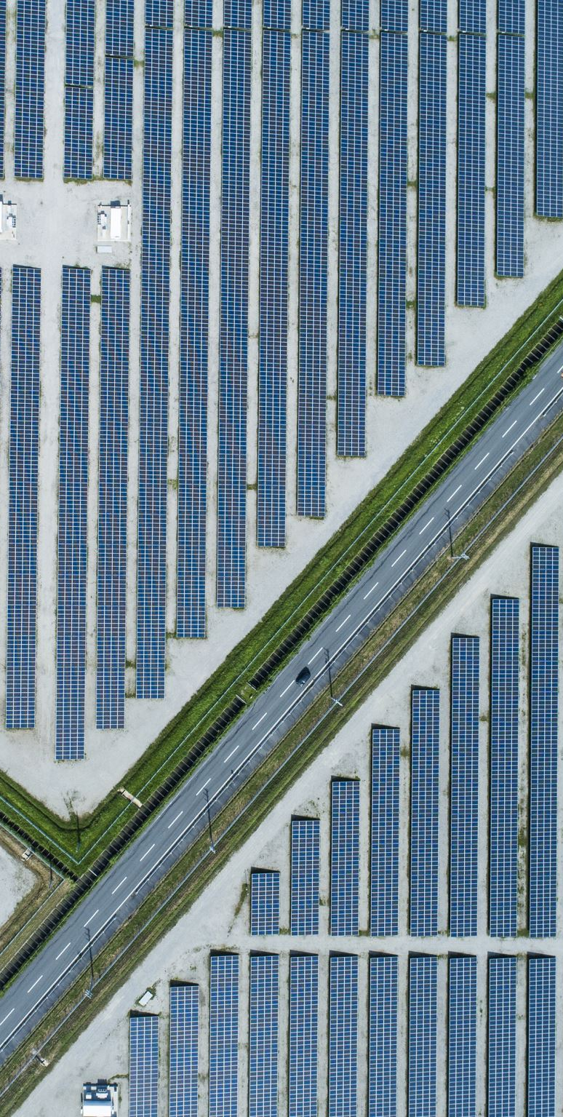
Nick Duplex (22967258)
COST MANAGEMENT: Early Estimate
Expected budget for a large-scale solar farm to be roughly $90 million (APSRC, 2016).
Close-proximity of the chosen project site to an already existing power substation dramatically lowered costs
This was perhaps the most significant choice related to cost management throughout the entire project. (B. Guo, personal interview, 5 April 2024).

Slide 8
Nick Duplex (22967258)
COST MANAGEMENT: Revised Budget Steps
Average tender offer $115,000,000
Negotiated down to $102,472,000 with UGL for them to become the preferred contractor (Genex/ARENA, 2017).
Various hedging methods were used, however heavy foreign exchange costs were incurred
Required Genex to return to its shareholders for a second round of equity capital raising
Revised budget of $126 million
Example of a bottom-up / vendor bid analysis approach to budgeting
A firm grasp on the total costs only became apparent after negotiations with contractors were complete. (B. Guo, personal interview, 5 April 2024)

Slide 9
Nick Duplex (22967258)
COST MANAGEMENT
Finalisation
Recommendations
FINANCIAL PROJECTIONS DURING FINALISATION (all annual):
O&M costs of $1,530,000,
$147,000 insurance costs
Assumed inflation of 2.5%
Degradation of 0.35%
Project IRR of 9.295% based on a lifetime of 25 years (Genex/ARENA, 2017).
Implementing more sophisticated hedging mechanisms such as forward and futures contracts
Closely monitoring currency fluctuations to mitigate the impact of unforeseen market volatility.
Conducting a thorough review of the project's financial model and incorporating contingency plans to address currency exchange rate fluctuations

Slide 10
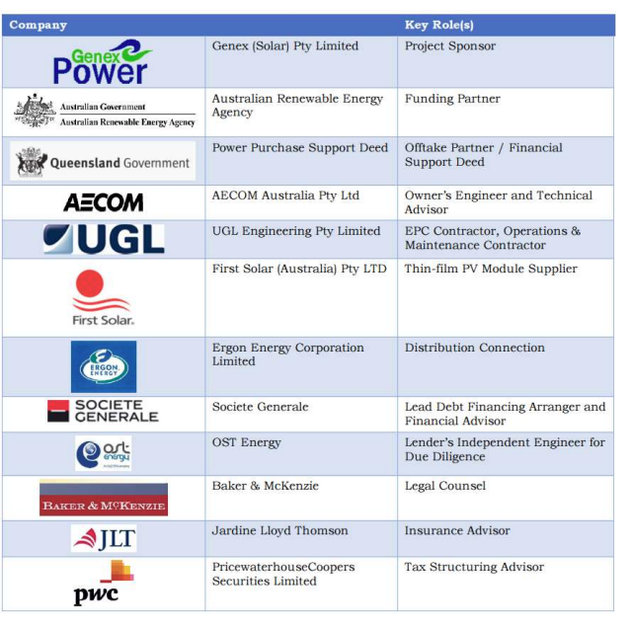
Stakeholders and communications
Mick Luu (22970102)
Key stakeholders and their roles in the project.
Genex Power, (2017)

Slide 11
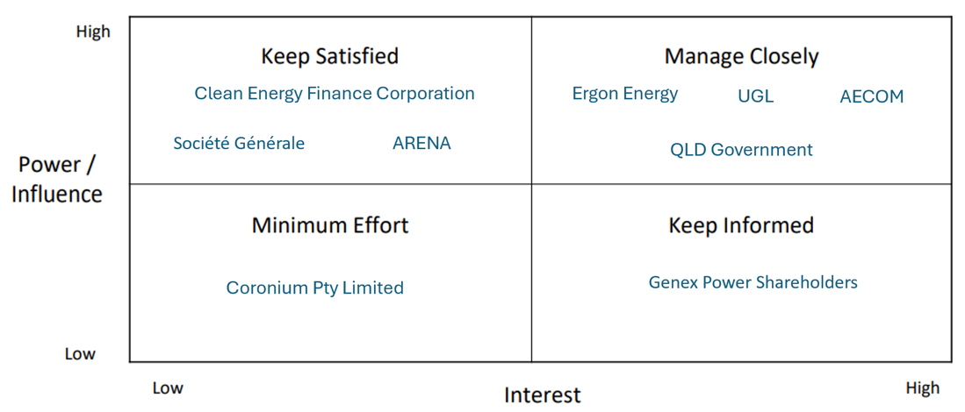
Conceptualization stage
Mick Luu (22970102)
Approvals and Support (Concept Stage):
Acquired freehold land, development, and environmental approvals.
Collaborated with Queensland Government's DEHP.
Secured support from ARENA and a 20-year revenue guarantee from QLD government.
Agreement with Ergon Energy for substation use.
Funding and Appointments:
Arranged debt funding with Societe Generale and Clean Energy Finance.
Appointed AECOM as owner’s engineer.
Appointed UGL as preferred EPC & O&M contractor.

Slide 12
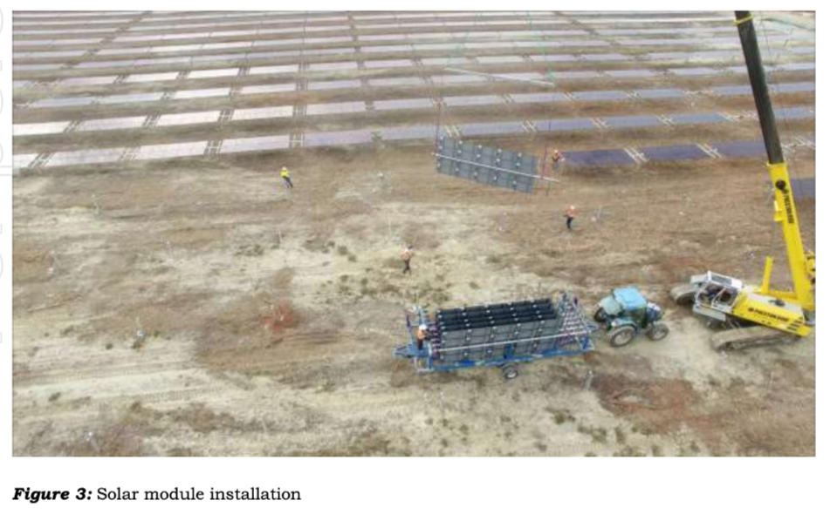
Execution stage
Mick Luu (22970102)
Construction Project Overview
Clear Communication: Effective updates via ASX announcements.
Detailed Execution: Ongoing construction tasks detailed with visuals in Appendix D (ASX, 2017).
Dispute Resolution
Issue: Dispute over grid connection delays.
Outcome: UGL pays Genex over $5 million for delays and legal costs.
Strategy: Compromise to manage stakeholder pressures.
Genex (2016) ASX Announcement

Slide 13
Finalisation stages of stakeholder management
Mick Luu (22970102)
UGL Responsibilities Post-Finalization:
Manages operations and maintenance of KS1.
Collaborates with Powerlink to promote local employment.
Local Employment Opportunities:
Includes waste management, recycling, access works, cleaning services, and equipment hire.
Genex Achievements:
Registered KS1 as a Market Generator with AEMO.
Completed all necessary technical and regulatory processes.
Enabled export of electricity into the National Electricity Market (NEM).

Slide 14
Recommendations
Mick Luu (22970102)
Improving Communications in Planning:
Conduct a kick-off meeting with project team and stakeholders.
Establish clear purpose and common goals.
Continuous Reporting:
Use progress, status, and forecast reports to manage project status.
Identify and address issues in real-time.
Project Control in Finalization:
Monitor asset performance through regular inspections.
Use milestone and control charts for clear planning.
Maintain contingency plans and change registers to track project changes.

Slide 15
Quality management
Ken Ji (21671765)
Quality management has a more strategic and central presence within and across the project organization. (Hartley 2018, P241)

Slide 16
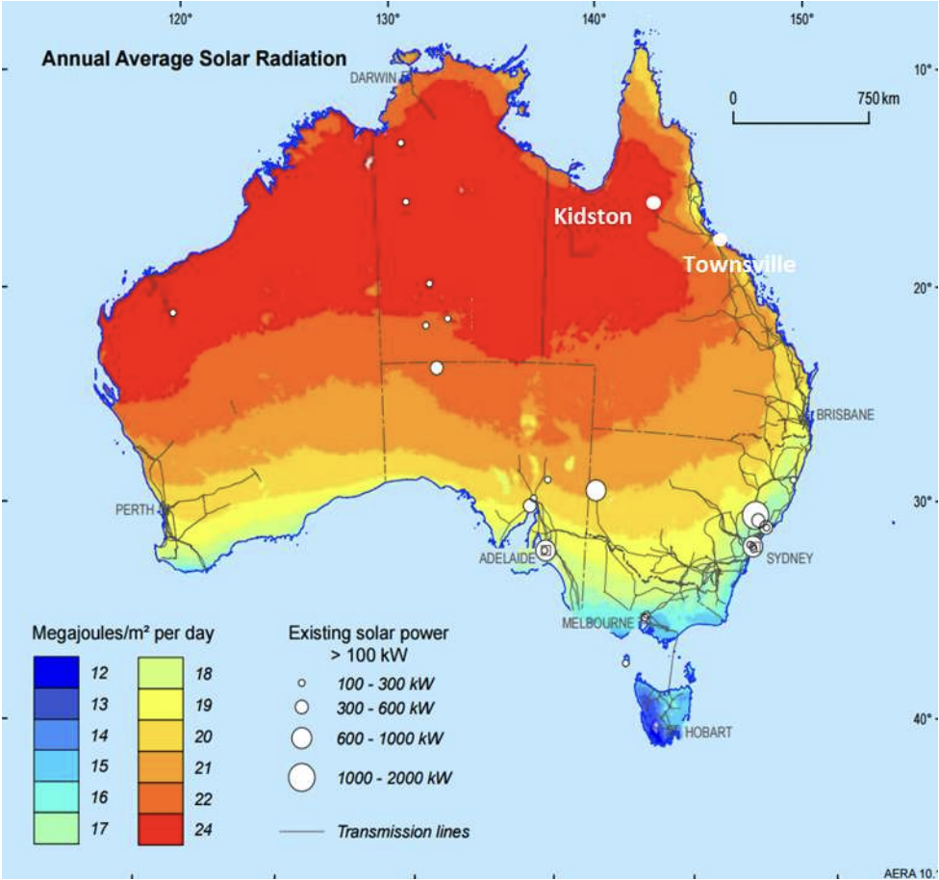
Quality management strategies employed by Genex Power:
Ken Ji (21671765)
Location Selection:
location boasts one of the highest solar radiation zones in the country, making it ideal for solar energy generation. (ASX, 2016)
coupled with access to existing infrastructure like substations and transmission lines, facilitates efficient energy distribution. (Power Technology, 2021)
situating the solar farm at the former mine site mitigates environmental impacts, particularly concerning the existing tailings storage facility. (Power Technology, 2021)

Slide 17

Quality management tactics implemented by AECOM and UGL include:
Ken Ji (21671765)
Compliance with Standards:
The EPC Contractor adheres to stringent quality assurance protocols, in line with ISO 9001 management guidelines for construction activities.(Crowley A., 2022)
Project Quality Assurance system
Quality Management Plan
Construction Execution Plans (CEPs)
Inspection and Test Plans (ITPs)
meticulous documentation

Slide 18
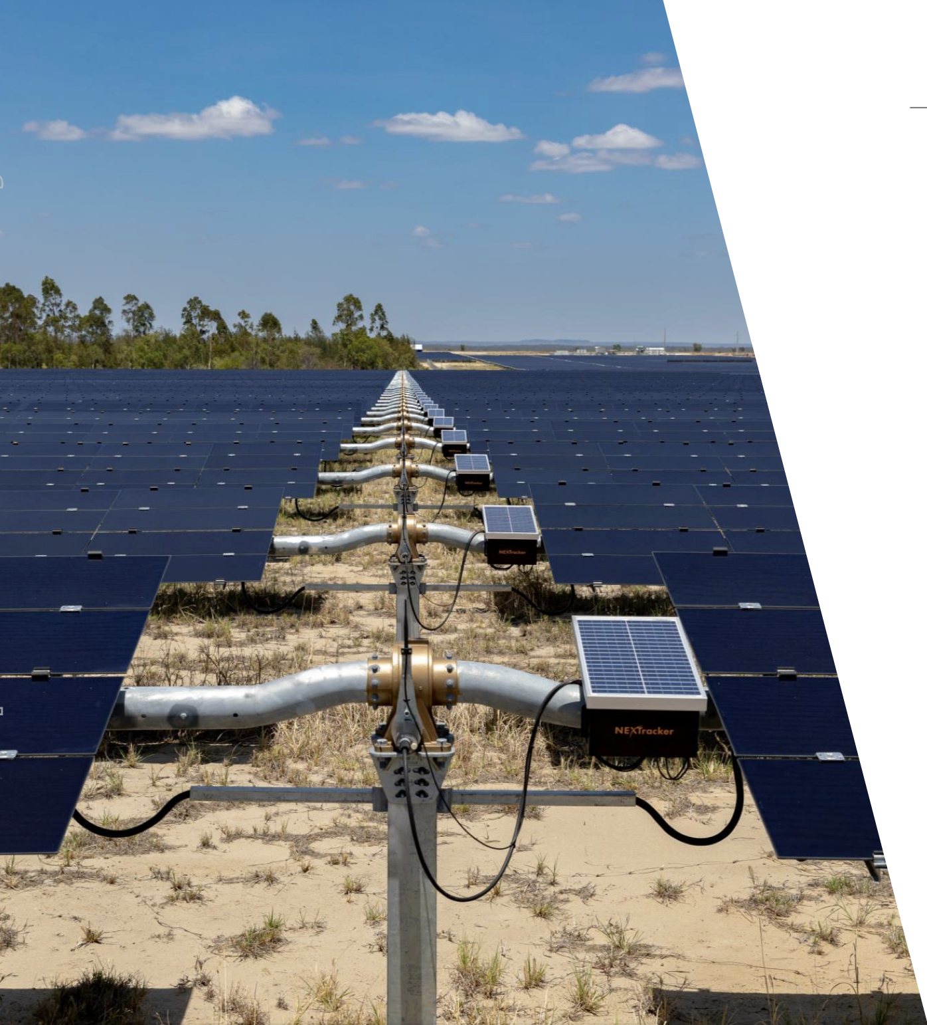
Quality management tactics implemented by AECOM and UGL include:
Ken Ji (21671765)
Utilization of Innovative Technology:
Use First Solar's 4v3 Modules (S4-Modules), for their performance and reliability in various climates worldwide. (Power Technology, 2021)
Mounted on a tracking system, optimize sunlight capture by adjusting panel angles to follow the sun's trajectory. (ARENA, 2022)

Slide 19
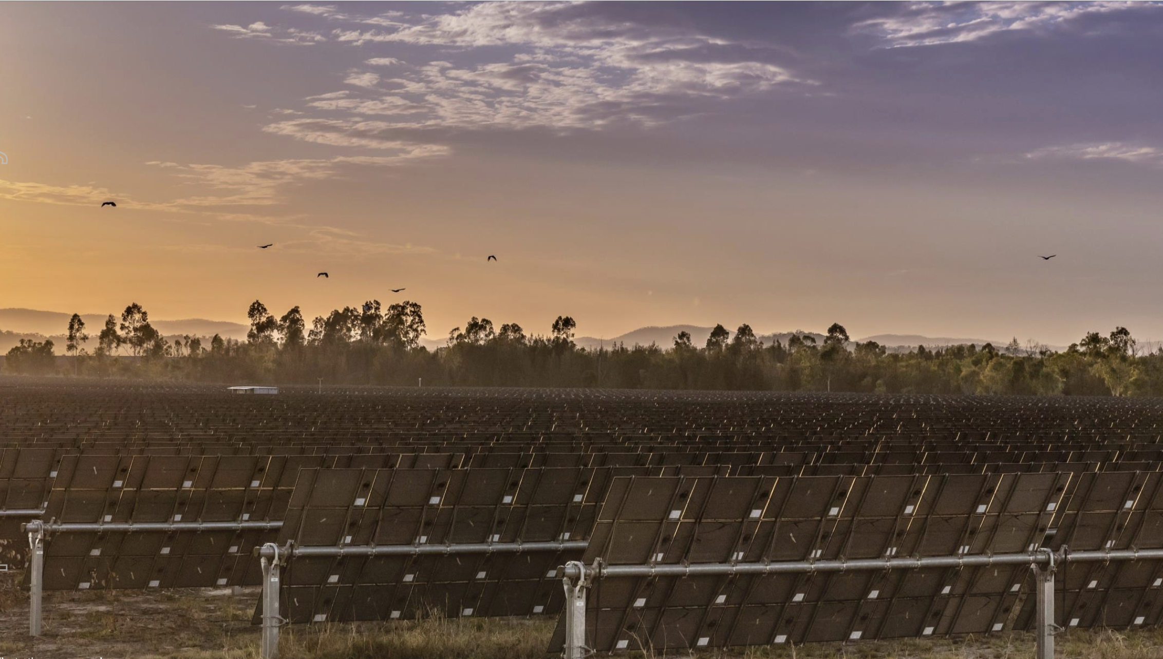
Ken Ji (21671765)

Slide 20
Risk Management
Name: Pritam Suwal Shrestha
Student Id: 23771397
An Inherent Component of Projects
With strategic management, risks associated with schedule, budget, quality, and stakeholders can be systematically identified, analysed, and managed
Allows teams to leverage insights gained from managing risks to enhance decision-making, refine strategies, and strengthen resilience against future challenges

Slide 21
Risk Assessment
Name: Pritam Suwal Shrestha
Student Id: 23771397

Slide 22
Environmental and Social Considerations
Name: Pritam Suwal Shrestha
Student Id: 23771397
Initial risk assessment focused on potential objections from local landowners and biodiversity concerns
Location on an abandoned mine site minimized environmental and social risks

Slide 23
International Procurement and Financial Risks
Name: Pritam Suwal Shrestha
Student Id: 23771397
Equipment sourced from international suppliers like First Solar , SMA , and NEXTracker
Foreign exchange financial risk introduced additional complexities for project financing
Inexperienced teams heightened risks due to uncertainty in costs and lack of historical data on similar projects

Slide 24
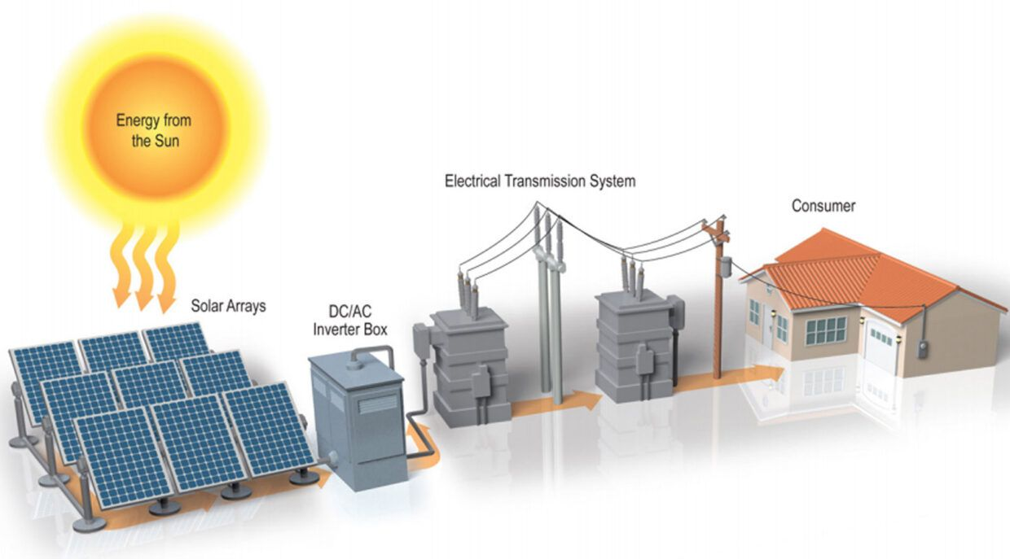
Grid Connection Challenges
Name: Pritam Suwal Shrestha
Student Id: 23771397
Grid connection providers often being government entities resulted in non-negotiable terms on price and connection timing
Grid connection was identified as the longest and riskiest part of the project

Slide 25
Planning Stage Risk Management
Name: Pritam Suwal Shrestha
Student Id: 23771397

Slide 26

Risk Transfer Mechanism
Name: Pritam Suwal Shrestha
Student Id: 23771397
Genex transferred construction and finalisation risks to UGL, ensuring they handled potential issues like equipment malfunctions or construction delays

Slide 27
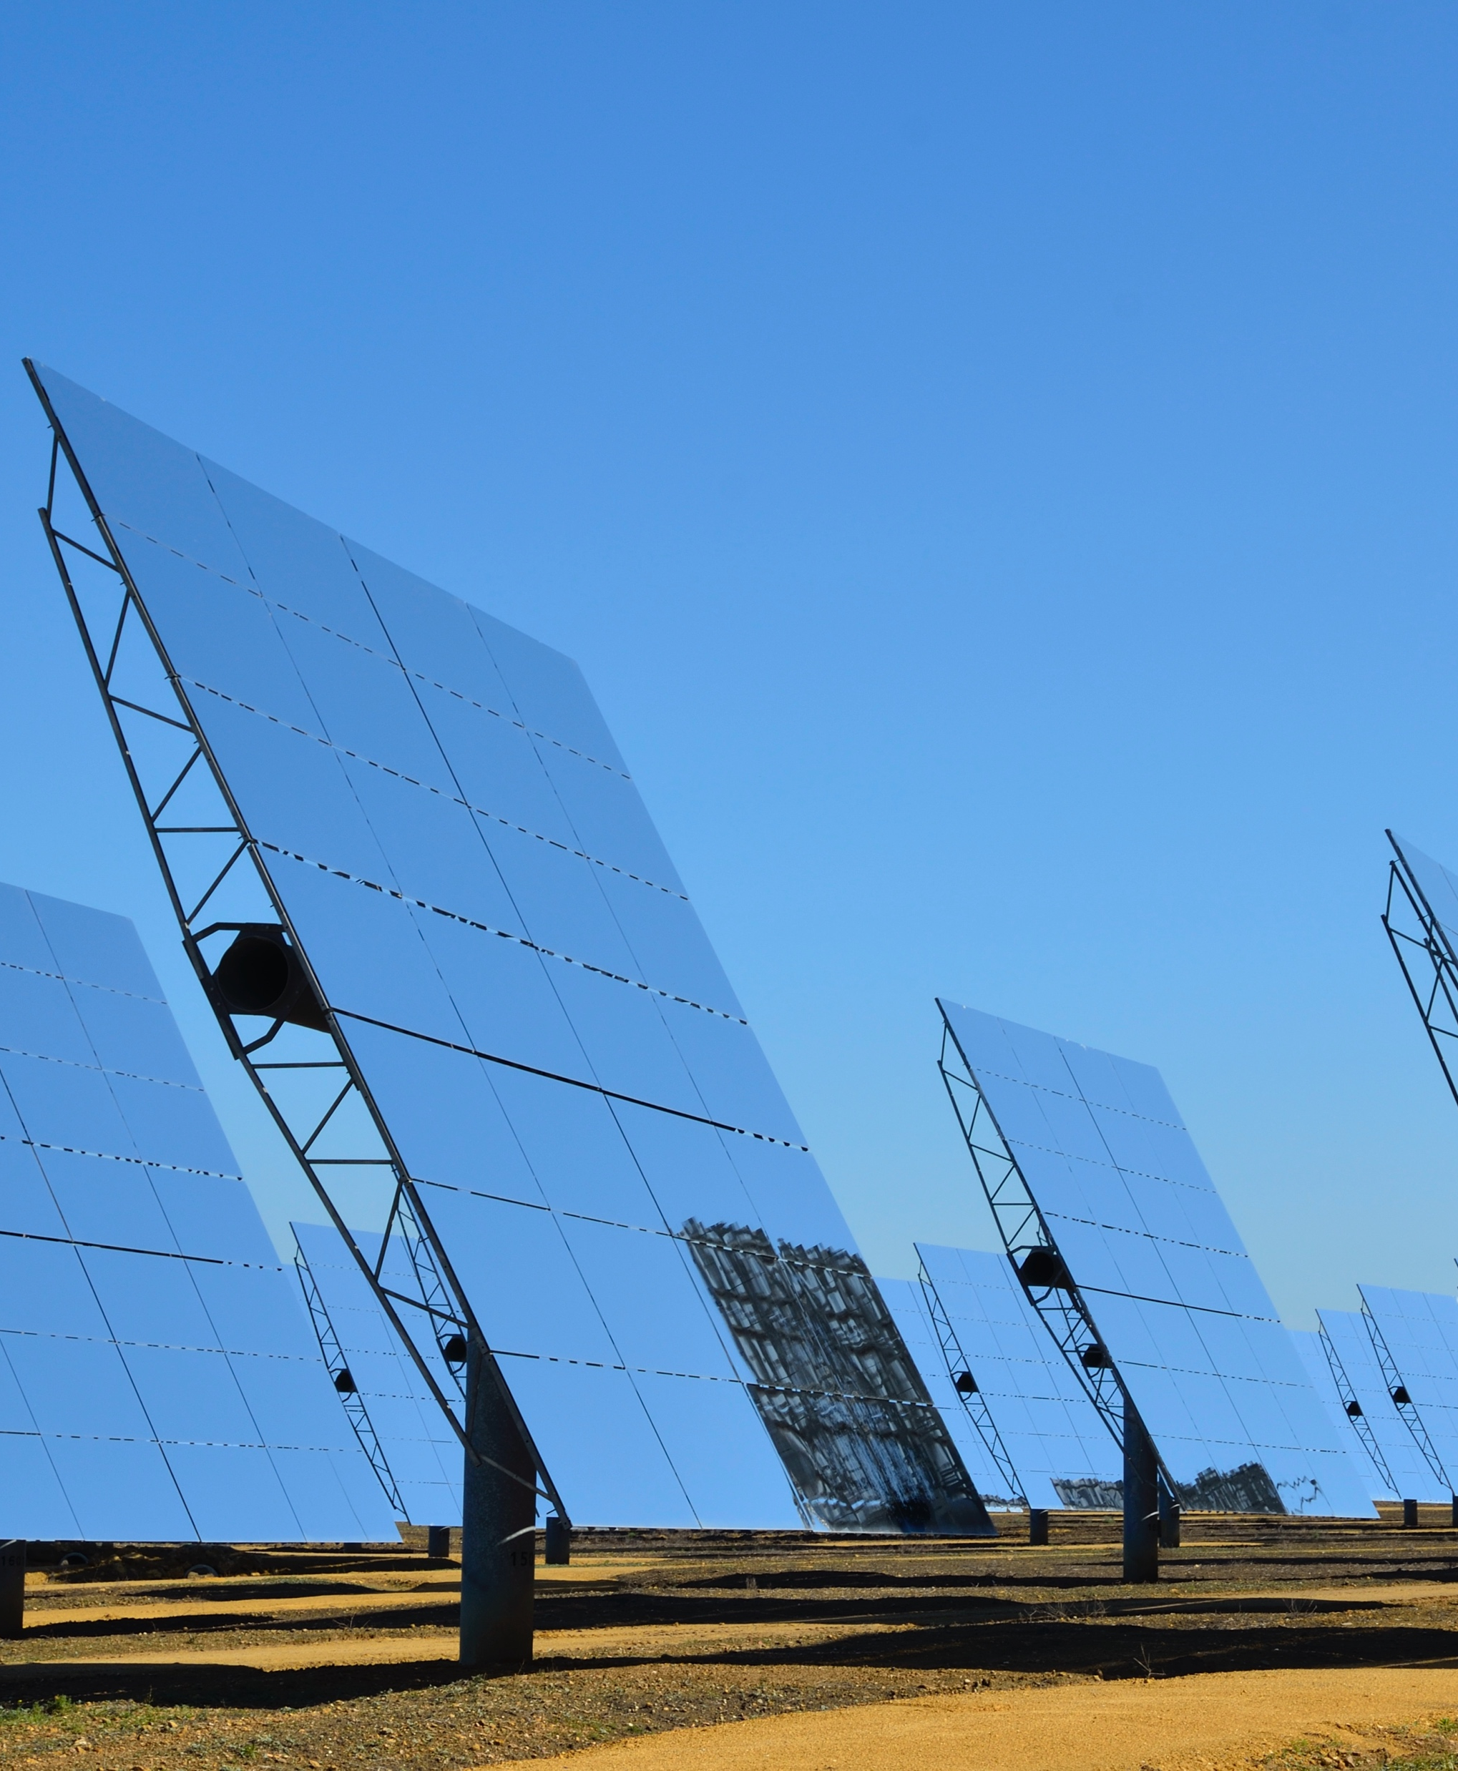


Revenue Assurance
Name: Pritam Suwal Shrestha
Student Id: 23771397
Power Purchase Agreements signed with Origin Energy and Energy Australia for 10 to 20 years, enhancing revenue certainty

Slide 28
Execution and Future Risk Management Strategies
Name: Pritam Suwal Shrestha
Student Id: 23771397

Slide 29
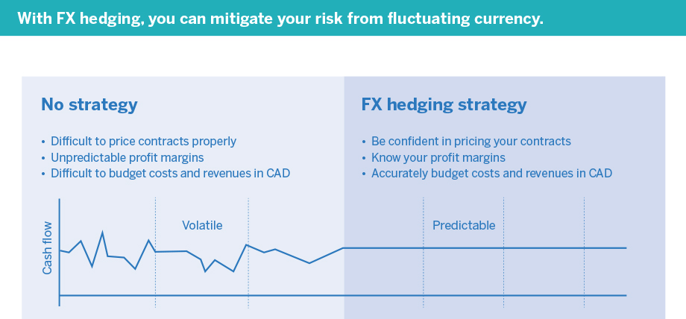
Enhanced Hedging Mechanisms
Name: Pritam Suwal Shrestha
Student Id: 23771397
Implement more sophisticated hedging mechanisms like forward and futures contracts to mitigate unforeseen market volatility

Slide 30
Risk Register Utilization
Name: Pritam Suwal Shrestha
Student Id: 23771397
Use of a risk register to identify potential setbacks within the project and implement controls for better project budget management and stakeholder expectation management
Risk Event | Probability | Impact | Priority | Strategy | Accountability
Grid Connection Delays | 4 | Catastrophic (5) | 20 | Expedite negotiations and approvals with grid operators | Project Manager
Cost Overruns due to Currency Fluctuations | 3 | Major (4) | 12 | Implement financial hedging strategies | Financial Manager
Supply Chain Disruptions for Solar Panels | 3 | Major (4) | 12 | Develop alternative supplier relationships | Procurement Manager
Environmental Permit Delays | 2 | Moderate (3) | 6 | Engage early with regulatory bodies | Environmental Officer
Community Opposition | 2 | Moderate (3) | 6 | Strengthen community engagement plans | Community Liaison

Slide 31
PESTELG Framework Application
Name: Pritam Suwal Shrestha
Student Id: 23771397
Identification of external factors impacting the project including Political, Economic, Social, Technological, Environmental, Legal, and Global factors
Emphasis on early engagement with grid operators and regulatory authorities to avoid project delays

Slide 32
Comprehensive Feasibility Studies
Name: Pritam Suwal Shrestha
Student Id: 23771397
Advised to conduct extensive studies beyond solar radiation richness to identify and plan for potential challenges
Adequate budgeting and resource allocation for timely grid connection completion recommended

Slide 33
Time Management
Tatenda Makova (23072009)

Slide 34
Importance Of Time Management
Tatenda Makova (23072009)
Time Management is necessary to complete a project in a timely manner acceptable to stakeholders
Presented as a schedule management plan
Achieved through defining the activities and their sequencing, estimating activity durations and creating the baseline and actual plan (Hartley 2018, p.172)

Slide 35
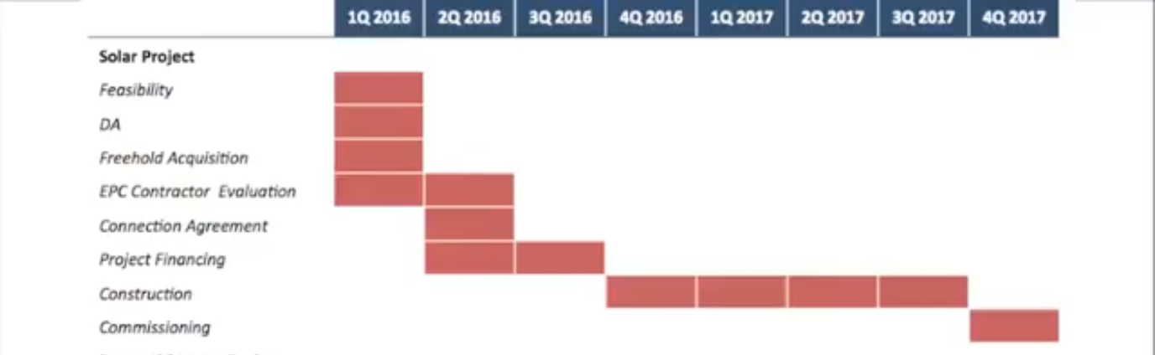
Planning stage
Tatenda Makova (23072009)
Genex’s schedule management planning is presented in a Gantt Chart
Illustrates unique identifiers of the activities, activity durations, imposed dates, the project calendar, and logical relationships in a straightforward way.
Time durations were estimated using expert judgement, group decision-making and parametric estimates
Lacks meaningful description of each activity and excludes important information such as resource requirements, underlying assumptions, relevant constraints, and reference requirements.
(Genex Power, 2016)

Slide 36
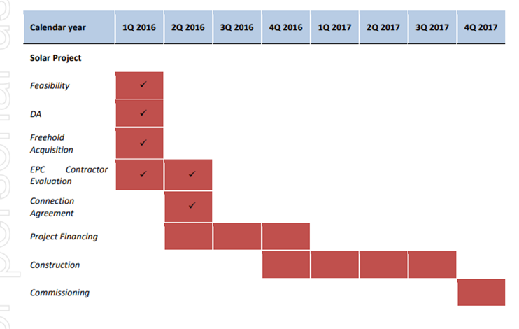
Execution Stage
Tatenda Makova (23072009)
Delays in project finance activity resulted in the original plan needing to be altered
Genex was able to start the construction stage before financial closure by taking advantage of lead time
Original Plan
Revised Plan
(Genex Power, 2016)
(Genex Power, 2016)

Slide 37
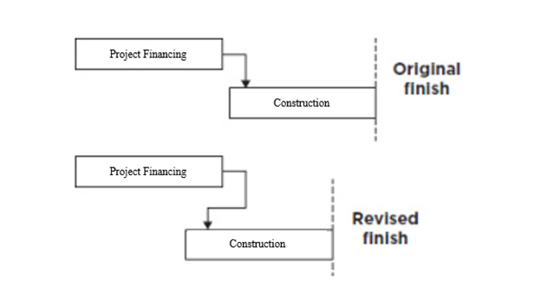
Tatenda Makova (23072009)
Adapted From (Hartley 2018, p.184)

Slide 38
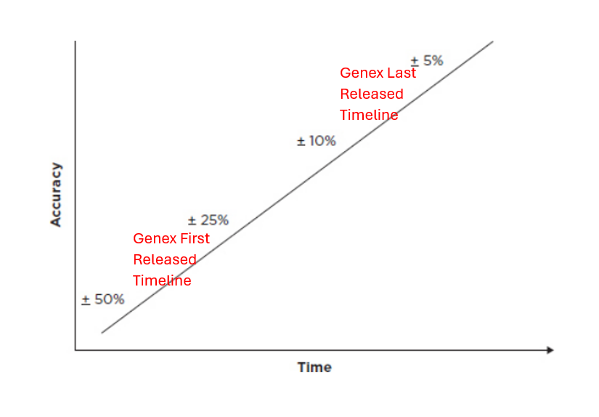
Tatenda Makova (23072009)
Adapted From (Hartley 2018, p.176)

Slide 39
Execution Stage
Tatenda Makova (23072009)
Unexpected Delays in Commissioning Stage
Practical completion 1 year later than planned
Demonstrates failure to identify the task dependencies, underestimating the effort required and a lack of understanding of what is required

Slide 40
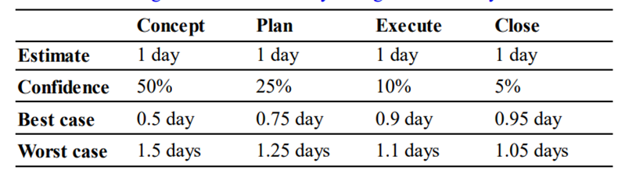
Recommendations
Tatenda Makova (23072009)
More expert judgement in planning phase
3-point estimate duration estimation technique
Greater understanding of resource capability
Implementation of a Work Breakdown Structure
(Hartley 2018, p.175)

Slide 41
Triple Bottom Line (TBL)
Rachel Tausem (23071639)
Social
Economic
Environmental

Slide 42
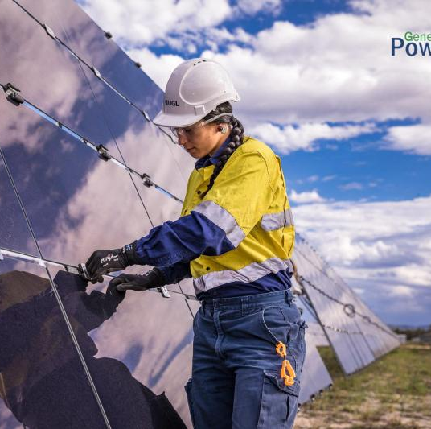
Social
Rachel Tausem (23071639)
Job Creation
170 jobs created during the construction phase
Promotes renewable energy
Contributes to the shift of the Australian energy sector towards renewables

Slide 43
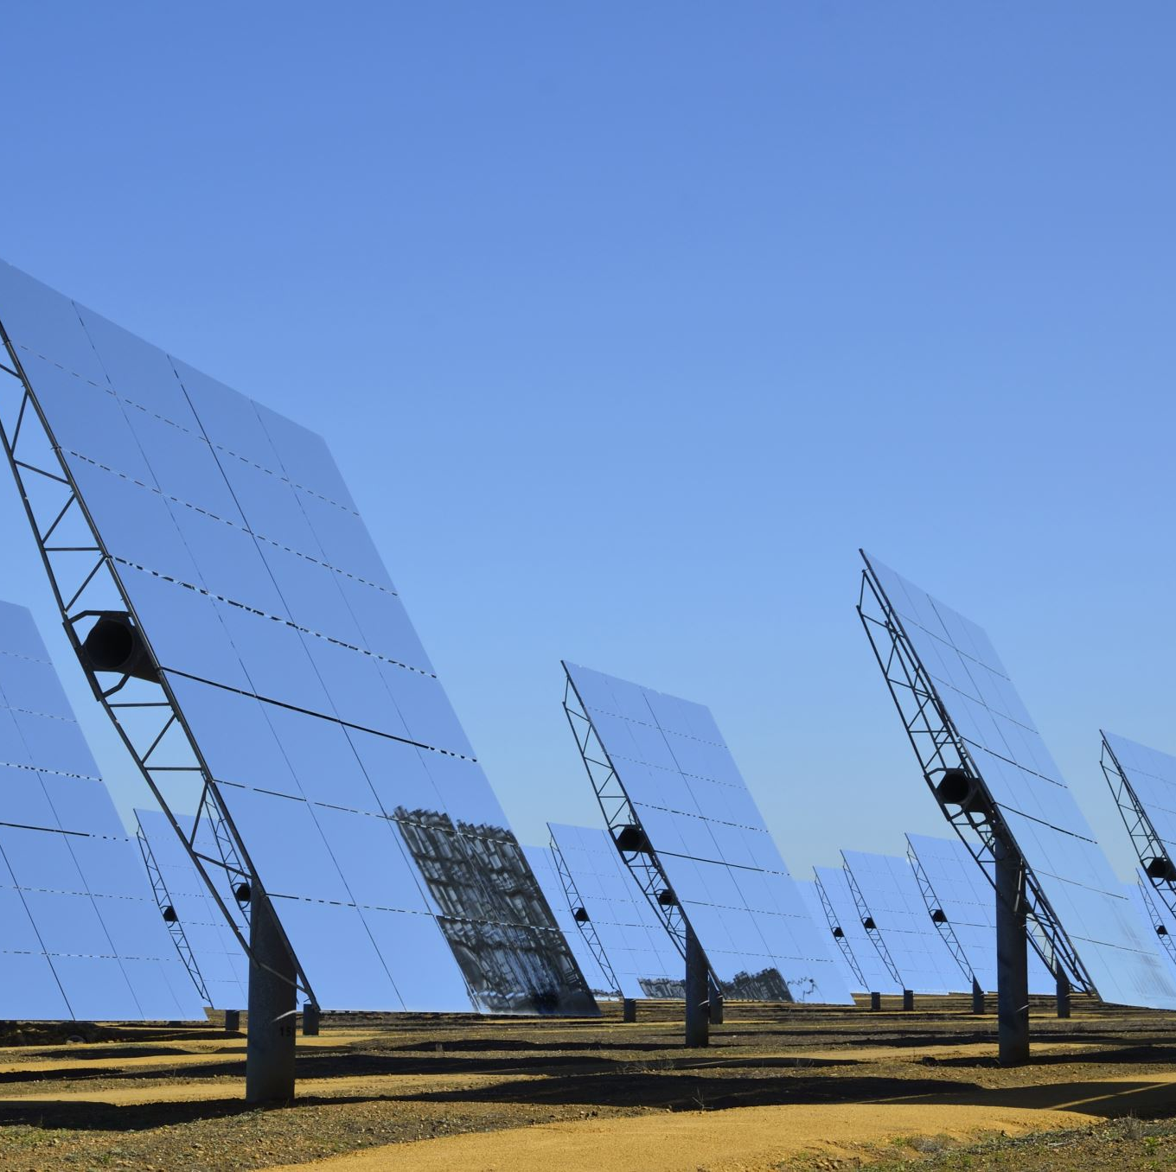
Economic
Rachel Tausem (23071639)
Power generation for up to 26,000 households
Stabilises electricity network in Northern Queensland
$13.3 million in net revenue in the first financial year after project completion

Slide 44

Environmental
Rachel Tausem (23071639)
Increased total renewable energy generation in Queensland by 6%
Offsets 120,000 tonnes of CO2 emissions per annum
Built on the abandoned Kidston Gold Mine
Water supply for construction and operation used from the nearby Kidston Dam

Slide 45
Conclusion
Rachel Tausem (23071639)

Slide 46
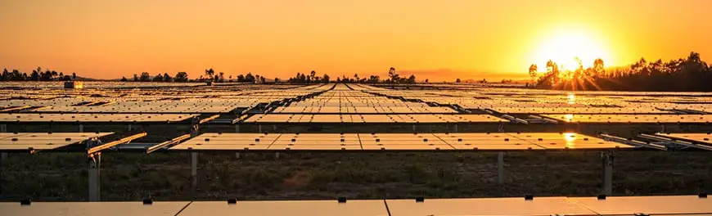
Summary
Rachel Tausem (23071639)
Project completion signifies a significant milestone in the company's renewable energy portfolio.
Throughout the project, several key issues emerged that impacted its success
Recommendations are proposed to avoid potential issues such as enhancing contractor selection processes to ensure expertise

Slide 47
References
Genex Power. (2016). GENEX FINALISES KIDSTON SOLAR PROJECT DELIVERY TEAM. https://cdn-api.markitdigital.com/apiman-gateway/ASX/asx-research/1.0/file/2995-01750692-2A956819
Hartley, S. (2018). Project management: a practical guide to planning and managing projects (Fourth edition.). Allen & Unwin.
Genex Power. (2017). GENEX ACHIEVES FIRST ENERGISATION FOR KIDSTON SOLAR STAGE 1. https://cdn-api.markitdigital.com/apiman-gateway/ASX/asx-research/1.0/file/2995-01925535-2A1051457

